Slide 1
Conducting on-chain ratings for sellers and buyers in e-commerce
Tomohiko Araki. Yumi Okuno.

Slide 2
1. Background and Problem Recognition
The cross-border e-commerce market is projected to reach approximately $5 trillion by 2025 (a year-on-year growth of +12%) and is expected to surpass $7 trillion by 2030.
However, losses from counterfeit goods and fraud amount to nearly $500 billion annually, with particularly high incidences in the fashion, cosmetics, and electronics sectors.
While the impact on buyers is severe, sellers also suffer from chargeback fraud and abuse of refund policies, resulting in significant financial damage. This mutual lack of trust between buyers and sellers has become a major barrier to further market expansion.

Slide 3
2. Structure of Existing Problems
Seller-side Issues
Chargeback Fraud (Friendly Fraud): Cases where buyers receive the product but falsely claim that it “did not arrive” and demand a refund.
Refund Policy Abuse: Includes unjustified returns after use, product swapping, or fraudulent returns.
Buyer-side Issues
Receiving counterfeit or poor-quality goods.
Products never arriving, with no refund provided.
Increasing damage caused by malicious e-commerce sites, often promoted through SNS advertisements.

Slide 4
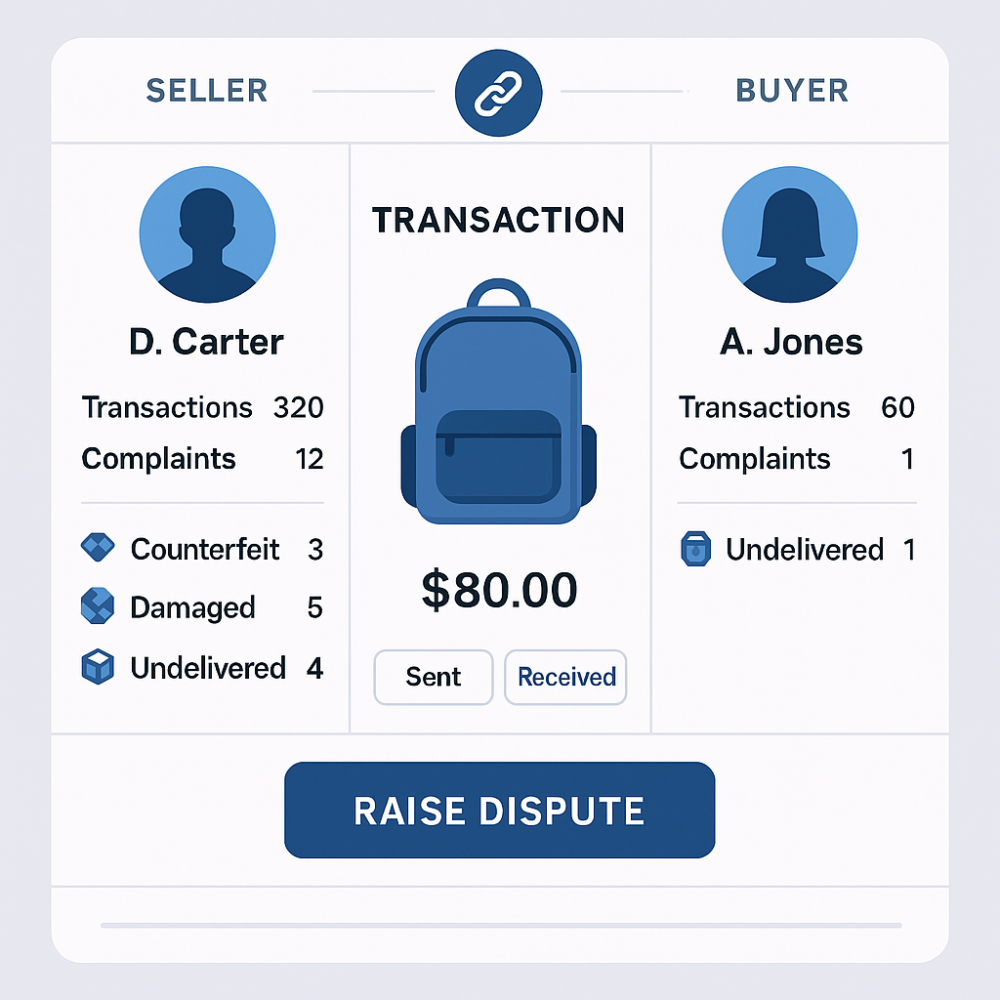
3. Basic Policy of Service Design
Design Favoring Sellers, While Eliminating Malicious Operators
Service fee: 3% of sales collected from sellers.
Transparency of transaction history and evaluations (negative reviews + transaction count) on-chain.
No positive evaluations are introduced, preventing manipulation and fake reviews.
Mechanisms for Buyer Protection
A “Inspection Complete” button finalizes the payment only after the buyer confirms product arrival.
A “Dispute” button allows buyers to submit claims of counterfeit or non-delivery, with supporting evidence.
No immediate refund is provided; instead, if a seller is proven fraudulent through the accumulation of negative evaluations, the buyer is rewarded with a contribution fee.
Buyers’ dispute history is also viewable by sellers.

Slide 5
4. Incentive Design
Initial Proposal
No direct refunds to buyers; priority is placed on preventing future damages.
Contributing buyers are rewarded with a “Crown” badge and monetary rewards.
Considered Alternatives
A two-tier reward system (partial compensation + contribution reward) was examined.
However, it was rejected due to concerns that partial compensation could incentivize fraudulent claims.
Final Decision
In the initial phase, the focus is on transparency through negative evaluations + transaction counts + negative evaluation tags.
AI-based scoring will be introduced in Phase 2 as an enhancement.

Slide 6
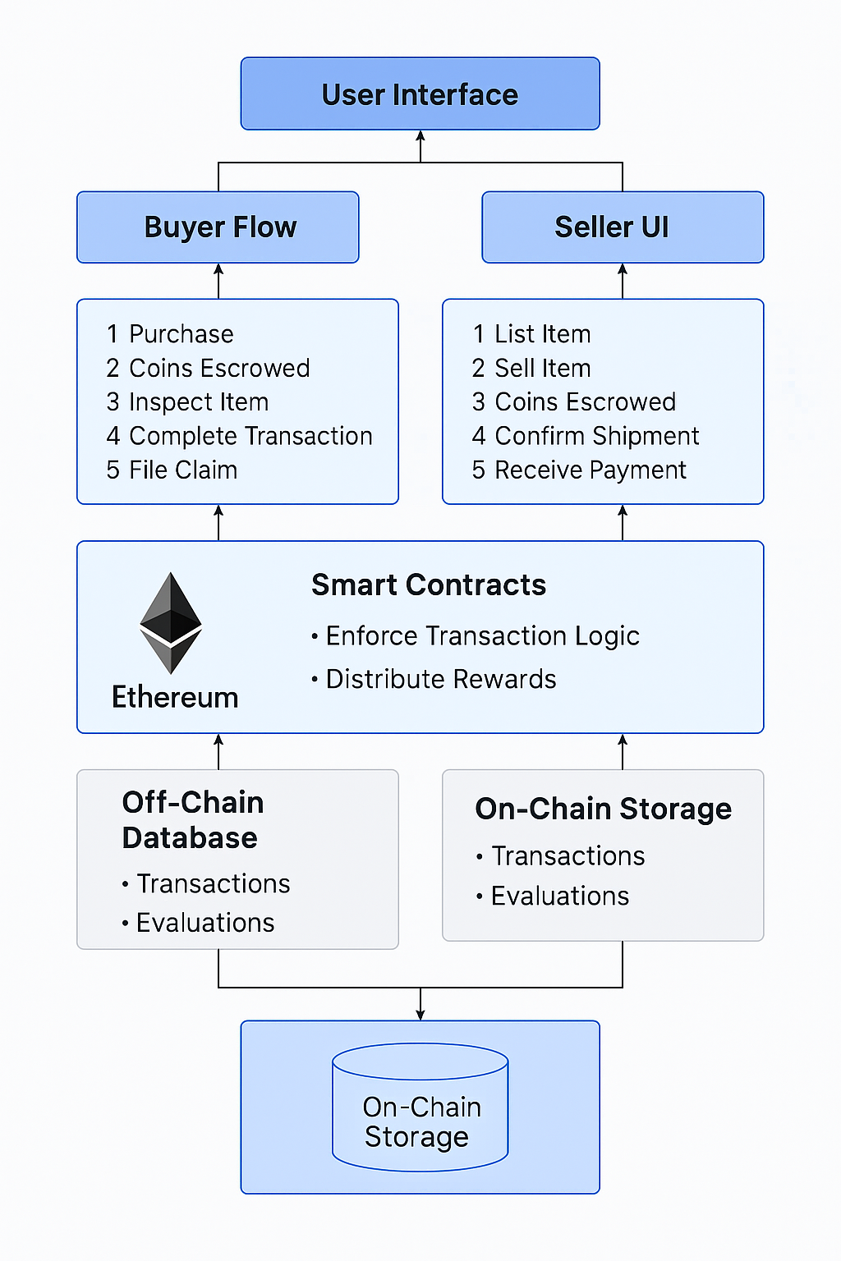
5. Operational & Expansion
Roadmap
Phase 1 (Initial Version)
Evaluation System: Negative review count, transaction count, and negative review tags.
On-chain history browsing functionality.
Payment hold & inspection approval flow for final settlement.
Phase 2 (Post Data Accumulation)
Introduction of AI scoring for trust and fraud detection.
High-accuracy fraud detection models leveraging historical patterns.
Expanded evaluation UI to visualize both sellers and buyers.

Slide 7
6. Strengths of This Design
Seller protection as the foundation, while elevating overall market trust through the visualization of fraudulent behavior.
Tamper-proof transaction records enabled by on-chain storage.
Balancing short-term and long-term impacts: reduces immediate refund costs while achieving mid-to-long-term fraud reduction and market revitalization.

Slide 8
Zircuit Specific
In cases of invalid transactions, I believe Zircuit’s Sequencer-Level Security (SLS) mechanism is particularly well-suited.

